Slide 1
Hackathon Plan
Context: generalizing SCHC over IP
draft-mglt-ipsecme-diet-esp
draft-ietf-schc-architecture
From paper board to code: design and test proposed formats for SCHC’o’IP

Slide 2
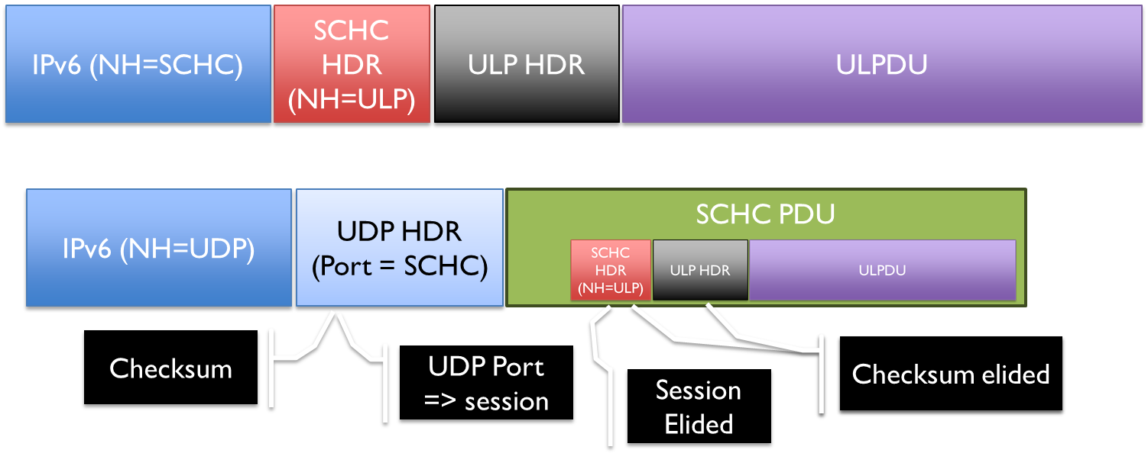

What got done
Designed SCHC packet formats inc. SCHC o UDP
openSCHC code
New formats for SCHC header and optional meta

Slide 3
What we learned
Multiple ways of doing SCHC over IP
draft-mglt-ipsecme-diet-esp not always saving
Saves only in full native mode where the SCHC header is compressed by SCHC
Will trigger a discussion at LPWAN / SCHC
Will update the SCHC architecture draft

Slide 4


Wrap Up
Team members:
Laurent Toutain
Pascal Thubert
Ana Minaburo (remote)
https://github.com/openschc/openschc

